Slide 1


Social Buzz Data Optimization Project

Slide 2


Today's agenda
Project recap
Problem
The Analytics team
Process
Insights
Summary

Slide 3

dg
Social Buzz, a rapidly growing technology unicorn, needs to adapt swiftly to its expanding global presence. Accenture has initiated a 3-month proof of concept (POC) focusing on the following tasks:
- Conducting an audit of Social Buzz's big data practices.
- Providing recommendations to ensure a successful IPO.
- Analyzing data to identify Social Buzz's top 5 most popular content categories.
Project Recap

Slide 4

Over 100000 posts per day
36,500,000 pieces of content per year!
But how to capitalize on it when there is so much?
Analysis to find Social Buzz's top 5 most popular categories of content
Problem

Slide 5
Process
1
Data understanding
Data Cleaning
2
3
Data modelling
4
Data Analysis
5
Insights

Slide 6


Insights

Slide 7
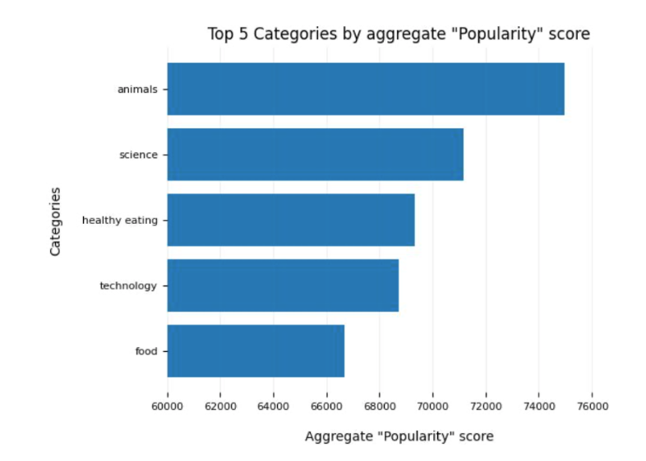

Slide 8
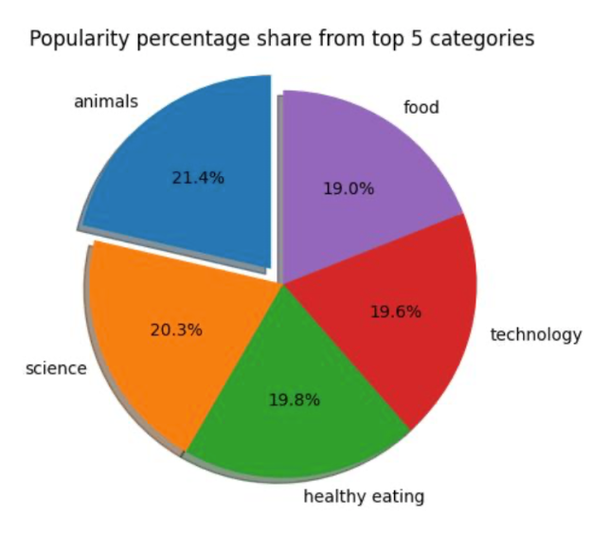

Slide 9

Analysis
The categories "Animals" and "Science" are the most popular, indicating a strong user preference for content that is rooted in "real-life" and factual information.
Insight
A common theme across the top 5 content categories is "Food," with "Healthy Eating" emerging as the highest-ranking subcategory. This suggests a significant interest within your user base in health-related topics. Leveraging this insight, you can develop targeted campaigns and partner with healthy eating brands to enhance user engagement.
Summary
Next Steps
While this ad-hoc analysis provides valuable insights, it's essential to scale this analysis for real-time, large-scale business intelligence. We can guide you through the process of implementing this capability to gain continuous, actionable understanding of your business.

Slide 10
Thank you!
ANY QUESTIONS?

